Slide 1
Batch Normalization
Dropout
Инна Тужикова

Slide 2
Batch Normalization
Batch Normalization: Accelerating Deep Network Training by Reducing Internal Covariate Shift.
Sergey Ioffe, Christian Szegedy, 2015
https://arxiv.org/pdf/1502.03167.pdf

Slide 3
Problem of Training Deep Networks
Very deep models involve the composition of several functions or layers. The gradient tells how to update each parameter, under the assumption that the other layers do not change. In practice, we update all of the layers simultaneously.
Deep Learning, 2016
Training Deep Neural Networks is complicated by the fact that the distribution of each layer’s inputs changes during training, as the parameters of the previous layers change. This slows down the training by requiring lower learning rates and careful parameter initialization, and makes it notoriously hard to train models with saturating nonlinearities.
Ioffe, Szegedy, 2015

Slide 4
Internal Covariate Shift
ICS: Change in the distributions of internal nodes of a deep network, in the course of training
Solution: reducing internal covariate shift via a normalization step that fixes the means and variances of layer inputs
Benefits: accelerates training (train faster, higher lr, less sensitive to the weights initialisation, makes more activation functions viable, some regularization)

Slide 5
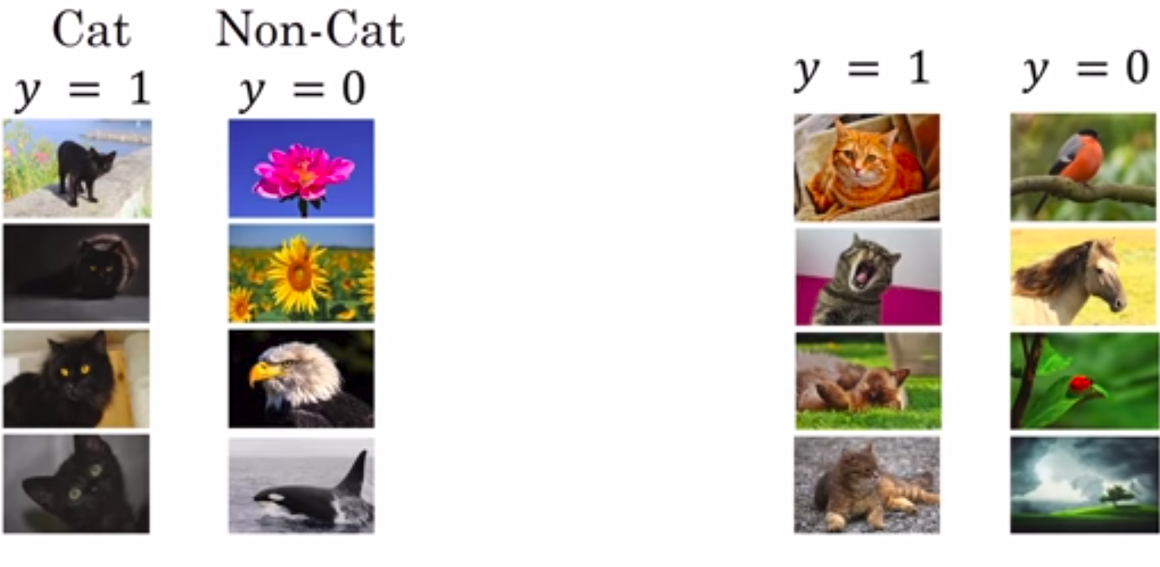
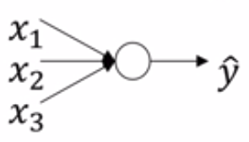
Learning on shifting input distribution

Slide 6
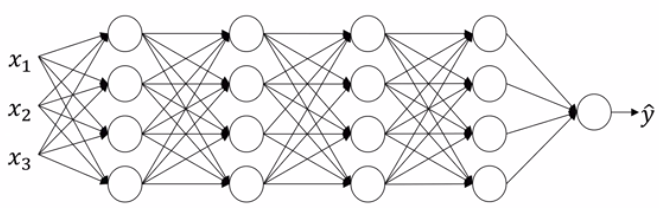
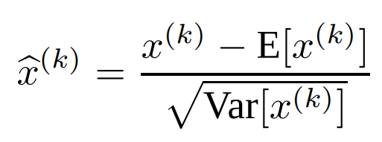
Batch Normalization
For a layer with d-dimensional input x = (x (1) . . . x(d) ), we will normalize each dimension:
Each mini-batch produces estimates of the mean and variance of each activation

Slide 7
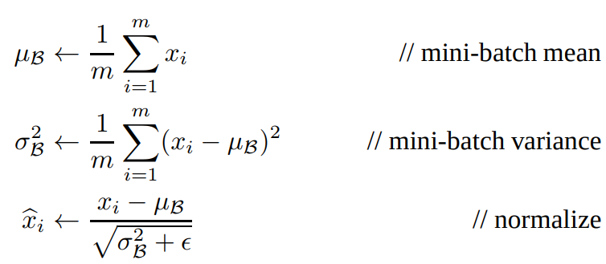
Batch Normalization

Slide 8
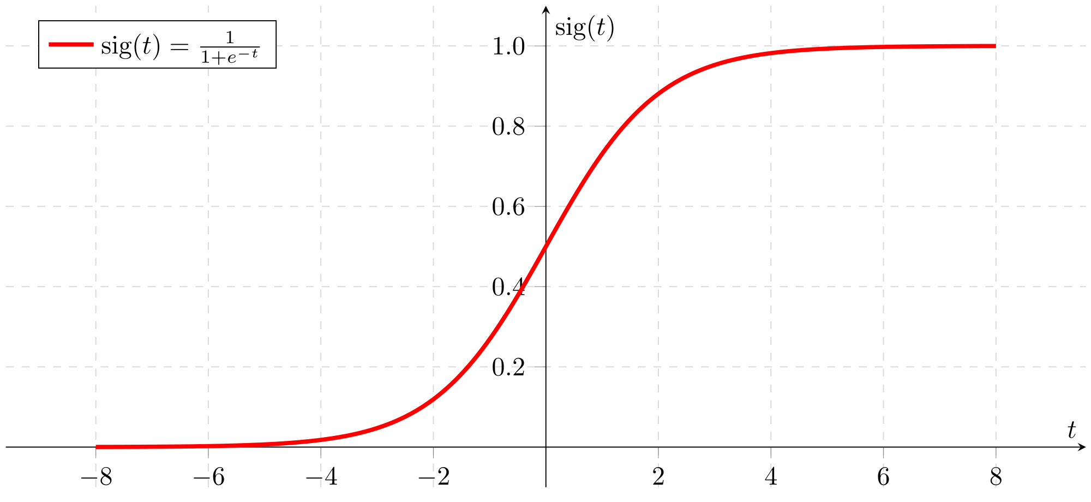
Sigmoid activation

Slide 9
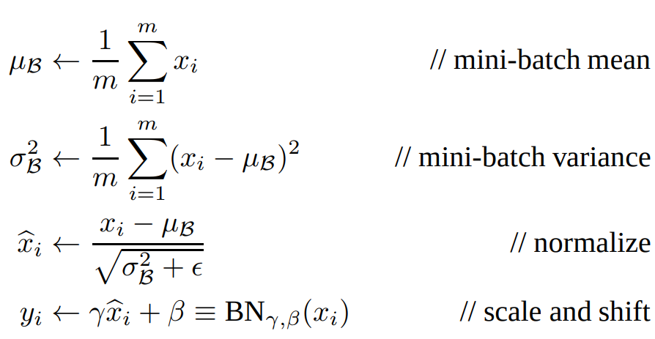
Batch Normalization

Slide 10
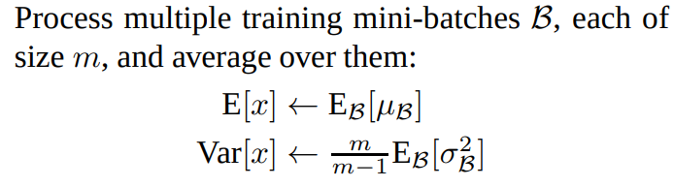

Batch Normalization on inference

Slide 11
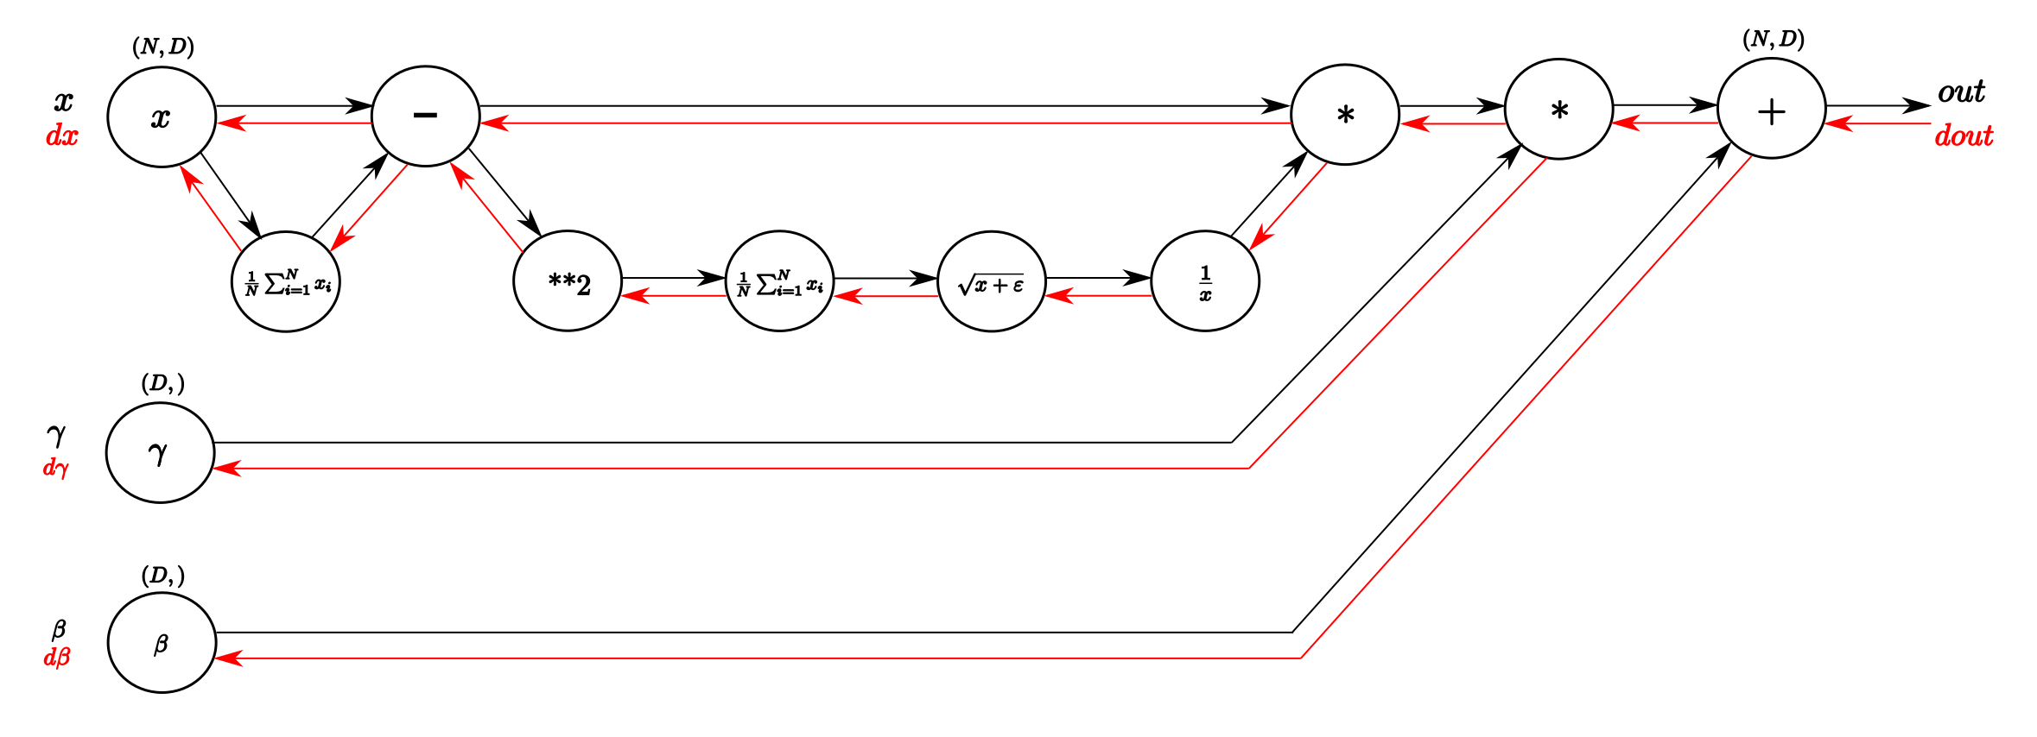
Batch Normalization: backprop

Slide 12
Before or after activation

Slide 13
Keras: BN
keras.layers.BatchNormalization(axis=-1, momentum=0.99, epsilon=0.001, center=True, scale=True, beta_initializer='zeros', gamma_initializer='ones', moving_mean_initializer='zeros', moving_variance_initializer='ones', beta_regularizer=None, gamma_regularizer=None, beta_constraint=None, gamma_constraint=None)
keras.io, Normalization Layers

Slide 14
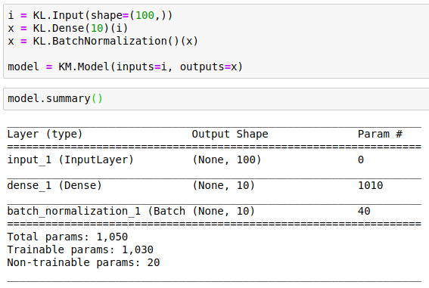
Keras: Batch Normalization
🙈
🤔

Slide 15
Keras: Batch Normalization

Slide 16
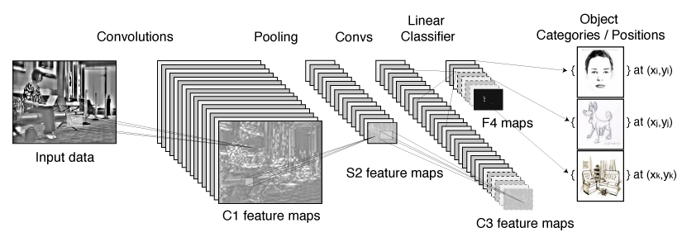
Batch Normalization: CNN
Convolutional property – different elements of the same feature map, at different locations, are normalized in the same way.
Jointly normalize all the activations in a minibatch, over all locations. For a mini-batch of size m and feature maps of size p × q, mini-batch size m′ = |B| = m · p q. We learn a pair of parameters γ and β per feature map, rather than per activation.

Slide 17
Batch Normalization: CNN, Keras
axis: Integer, the axis that should be normalized (typically the features axis). For instance, after a Conv2D layer with data_format="channels_first", set axis=1 in BatchNormalization.
keras.io, Normalization Layers

Slide 18
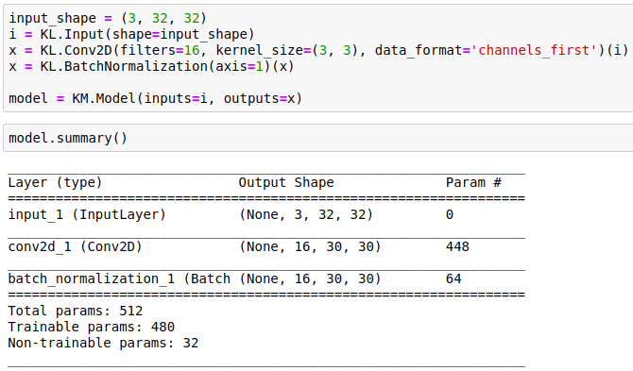
Keras: BN CNN
🙈
🤔
🦆

Slide 19
Keras: BN CNN

Slide 20
BN: Applications, Inception
5x5 -> 3x3 + 3x3 128
ReLu as nonlinearity: Conv -> BN -> ReLu
Increase learning rate
Remove Dropout
Reduce the L2 weight regularization (x0.2)
Accelerate the learning rate decay (x6 faster)
Shuffle training examples more thoroughly
Reduce the photometric distortions

Slide 21
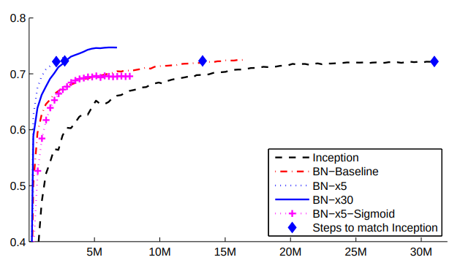
BN: Applications, Inception

Slide 22
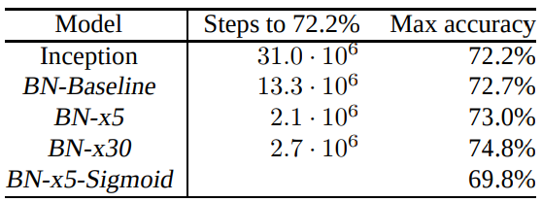
BN: Applications, Inception

Slide 23
Regularization
Adds some noise to the values within current mini-batch.
Slight regularization effect

Slide 24
Всё не так
The popular belief is that this effectiveness stems from controlling the change of the layers’ input distributions during training to reduce the so-called “internal covariate shift”. In this work, we demonstrate that such distributional stability of layer inputs has little to do with the success of BatchNorm.
BatchNorm might not even be reducing internal covariate shift
BatchNorm impacts network training in a fundamental way: it makes the landscape of the corresponding optimization problem significantly more smooth. This ensures, in particular, that the gradients are more predictive and thus allows for use of larger range of learning rates and faster network convergence
How Does Batch Normalization Help Optimization?, 2018

Slide 25
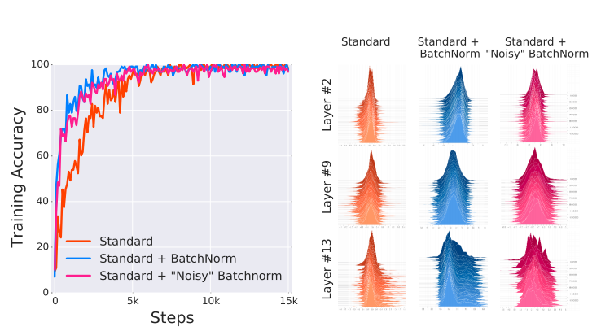
Всё не так

Slide 26
Всё не так
BN makes the gradients more reliable and predictive. It gives us confidence that when we take a larger step in a direction of a computed gradient, this gradient direction remains a fairly accurate estimate of the actual gradient direction after taking that step. It thus enables any (gradient–based) training algorithm to take larger steps without the danger of running into a sudden change of the loss landscape such as flat region (corresponding to vanishing gradient) or sharp local minimum (causing exploding gradients).
How Does Batch Normalization Help Optimization?, 2018

Slide 27
Dropout
Dropout: A Simple Way to Prevent Neural Networks from Overfitting, 2014

Slide 28
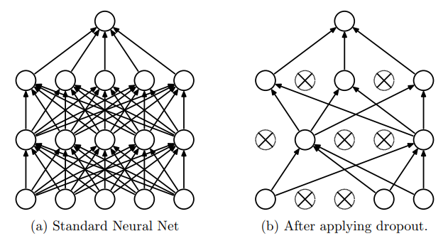
Dropout

Slide 29
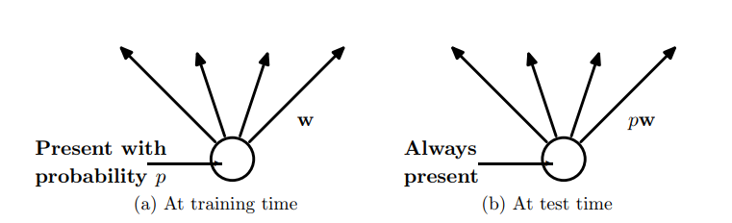
Dropout inference

